Slide 1
Object Oriented Programming Lab # 05 Understanding the implementation of Static Classes & Members
ENGR SANIYA SARIM

Slide 2
Static Members
The static keyword in Java is used for memory management mainly. We can apply static keyword with variables, methods, blocks and nested classes. The static keyword belongs to the class than an instance of the class.
The static can be:
Variable (also known as a class variable)
Method (also known as a class method)
Block
Nested class

Slide 3
Static Members
In Java, static members are those which belongs to the class and you can access these members without instantiating the class.

Slide 4
Static Methods
If you apply static keyword with any method, it is known as static method.
A static method belongs to the class rather than the object of a class.
A static method can be invoked without the need for creating an instance of a class.
A static method can access static data member and can change the value of it.

Slide 5
Static Methods
Static Methods − You can create a static method by using the keyword static.
Static methods can access only static fields, methods.
To access static methods there is no need to instantiate the class, you can do it just using the class name as −

Slide 6
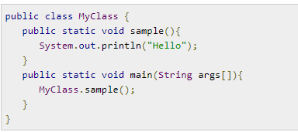
Static Method(Example1)

Slide 7
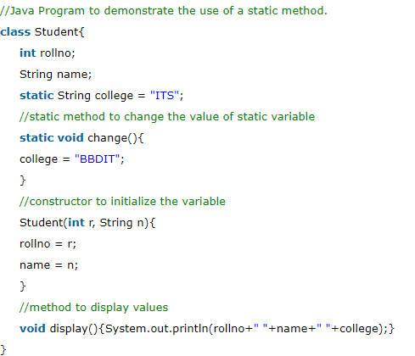
Static Method(Example 2)

Slide 8
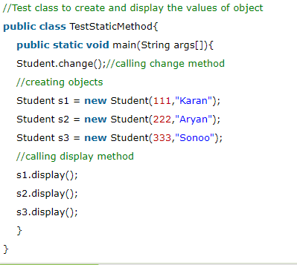
Static Method(Example 2 cont....)

Slide 9
Exercise
Calculate cube of a number in java using static method.

Slide 10
Static Fields
Static Fields − You can create a static field by using the keyword static. The static fields have the same value in all the instances of the class. These are created and initialized when the class is loaded for the first time.
Just like static methods you can access static fields using the class name (without instantiation).
If you declare any variable as static, it is known as a static variable.

Slide 11
Static Variable
The static variable can be used to refer to the common property of all objects (which is not unique for each object), for example, the company name of employees, college name of students, etc.
The static variable gets memory only once in the class area at the time of class loading.
It makes your program memory efficient (i.e., it saves memory).

Slide 12
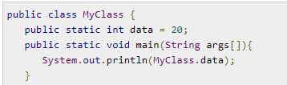
Example

Slide 13
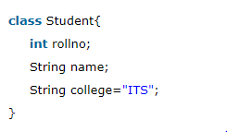
Static Variable (Example)
Suppose there are 500 students in my college, now all instance data members will get memory each time when the object is created. All students have its unique rollno and name, so instance data member is good in such case. Here, "college" refers to the common property of all objects. If we make it static, this field will get the memory only once.

Slide 14
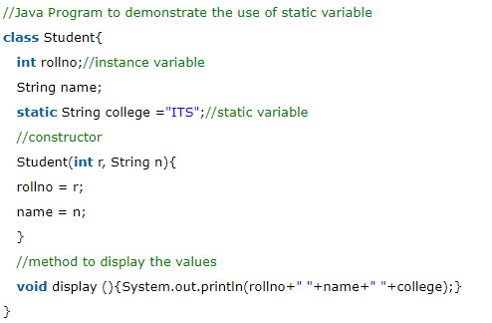
Example(Static Variable)

Slide 15
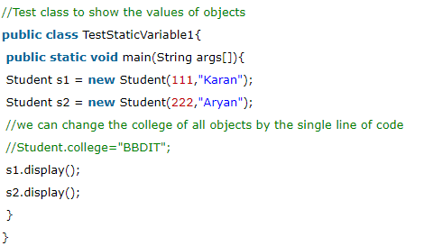
Example(Static Variable)

Slide 16
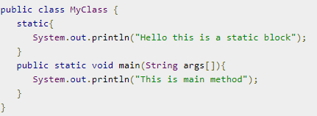
Static Blocks
Static Blocks − These are a block of codes with a static keyword. In general, these are used to initialize the static members.
JVM executes static blocks before the main method at the time of class loading.

Slide 17
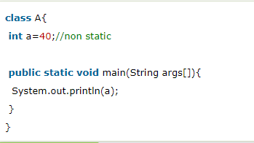
Restrictions for the static method
There are two main restrictions for the static method. They are:
The static method can not use non static data member or call non-static method directly.
this and super cannot be used in static context.

Slide 18
Static Nested Classes
You cannot use the static keyword with a class unless it is an inner class.
A static inner class is a nested class which is a static member of the outer class.
It can be accessed without instantiating the outer class, using other static members.
Just like static members, a static nested class does not have access to the instance variables and methods of the outer class.

Slide 19
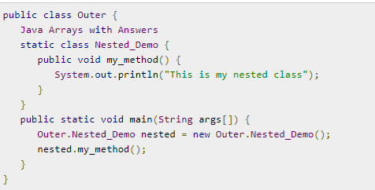
Example of Static Classes

Slide 20
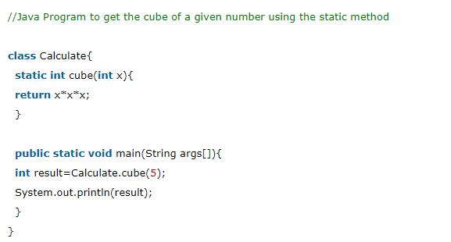
Exercise Solution

